Slide 1

Operation Analytics and Investigating Metric Spike

Slide 2

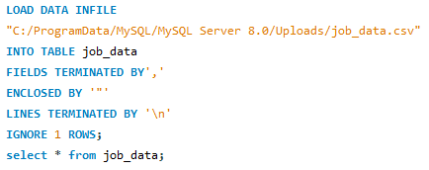
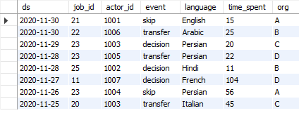
TASK:1 Job Data Analysis UPLODE EXEL CSV FILE: CODE
LOAD DATA INFILE
"C:/ProgramData/MySQL/MySQL Server 8.0/Uploads/job_data.csv“
INTO TABLE job_data
FIELDS TERMINATED BY',’
ENCLOSED BY '“’
LINES TERMINATED BY '\n’
IGNORE 1 ROWS;
select * from job_data;
ds | Job | actor | event | lang | time | org
2020-11-30 | 21 | 1001 | skip | English | 15 | A
2020-11-26 | 23 | 1004 | skip | Persian | 56 | A
2020-11-30 | 22 | 1006 | transfer | Arabic | 25 | B
2020-11-28 | 25 | 1002 | decision | Hindi | 11 | B
2020-11-29 | 23 | 1003 | decision | Persian | 20 | C
2020-11-25 | 20 | 1003 | transfer | Italian | 45 | C
2020-11-28 | 23 | 1005 | transfer | Persian | 22 | D
2020-11-27 | 11 | 1007 | decision | French | 104 | D

Slide 3
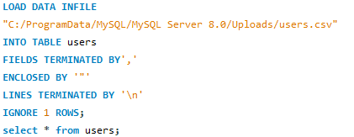
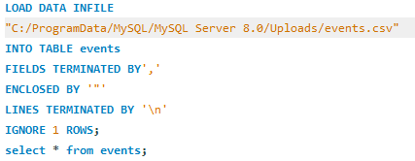
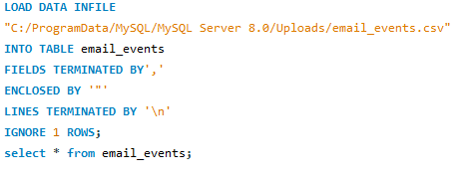
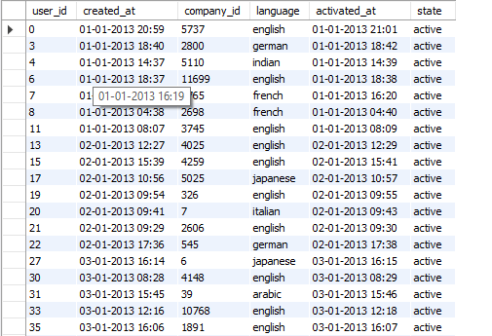
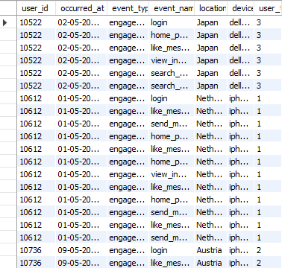
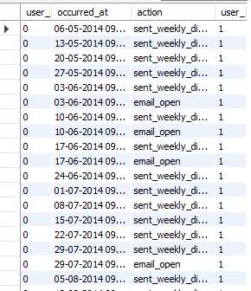
TASK:2 Investigating Metric Spike UPLODE EXEL CSV FILE: CODE

Slide 4



Tasks:
Weekly User Engagement:
Objective: Measure the activeness of users on a weekly basis.
Your Task: Write an SQL query to calculate the weekly user engagement.
User Growth Analysis:
Objective: Analyze the growth of users over time for a product.
Your Task: Write an SQL query to calculate the user growth for the product.
Weekly Retention Analysis:
Objective: Analyze the retention of users on a weekly basis after signing up for a product.
Your Task: Write an SQL query to calculate the weekly retention of users based on
their sign-up cohort.
Weekly Engagement Per Device:
Objective: Measure the activeness of users on a weekly basis per device.
Your Task: Write an SQL query to calculate the weekly engagement per device.
Email Engagement Analysis:
Objective: Analyze how users are engaging with the email service.
Your Task: Write an SQL query to calculate the email engagement metrics.
Tasks:
Jobs Reviewed Over Time:
Objective: Calculate the number of jobs reviewed per hour for each day in November 2020.
Your Task: Write an SQL query to calculate the number of jobs reviewed per hour for each day in November 2020.
Throughput Analysis:
Objective: Calculate the 7-day rolling average of throughput (number of events per second).
Your Task: Write an SQL query to calculate the 7-day rolling average of throughput. Additionally, explain whether you prefer using the daily metric or the 7-day rolling average for throughput, and why.
Language Share Analysis:
Objective: Calculate the percentage share of each language in the last 30 days.
Your Task: Write an SQL query to calculate the percentage share of each language over the last 30 days.
Duplicate Rows Detection:
Objective: Identify duplicate rows in the data.
Your Task: Write an SQL query to display duplicate rows from the job_data table.

Slide 5


Job Data Analysis

Slide 6




Job Data Analysis
Jobs Reviewed Over Time:

Slide 7

Jobs Reviewed Over Time:

Slide 8
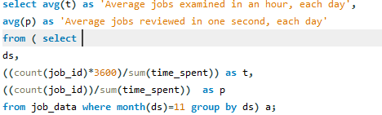
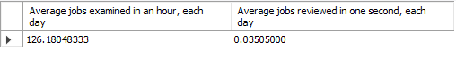
Jobs Reviewed Over Time:
select avg(t) as 'Average jobs examined in an hour, each day’,
avg(p) as 'Average jobs reviewed in one second, each day’
from ( select
ds,
((count(job_id)*3600)/sum(time_spent)) as t,
((count(job_id))/sum(time_spent)) as p
from job_data where month(ds)=11 group by ds) a;

Slide 9


Throughput Analysis:

Slide 10
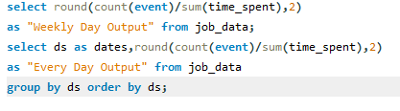
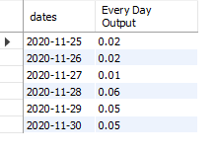
Throughput Analysis:
select round(count(event)/sum(time_spent),2)
as "Weekly Day Output" from job_data;
select ds as dates,round(count(event)/sum(time_spent),2)
as "Every Day Output" from job_data
group by ds order by ds;
Dates | Every Day Output
2020-11-25 | 0.02
2020-11-26 | 0.02
2020-11-27 | 0.01
2020-11-28 | 0.06
2020-11-29 | 0.05
2020-11-30 | 0.05

Slide 11

Language Share Analysis:

Slide 12
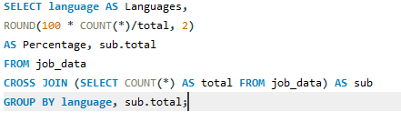
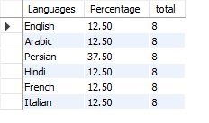
Language Share Analysis:
SELECT language AS Languages,
ROUND(100 * COUNT(*)/total, 2)
AS Percentage, sub.total
FROM job_data
CROSS JOIN (SELECT COUNT(*) AS total FROM job_data)
AS subGROUP BY language, sub.total;
Language | Percentage | Total
English | 12.50 | 8
Arabic | 12.50 | 8
Persian | 37.50 | 8
Hindi | 12.50 | 8
French | 12.50 | 8
Italian | 12.50 | 8

Slide 13

Duplicate Rows Detection:

Slide 14
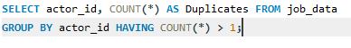
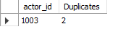
Duplicate Rows Detection:
SELECT actor_id, COUNT(*)
AS Duplicates FROM job_data
GROUP BY actor_id HAVING COUNT(*) > 1;

Slide 15

Investigating Metric Spike

Slide 16





Investigating Metric Spike

Slide 17

Weekly User Engagement:

Slide 18
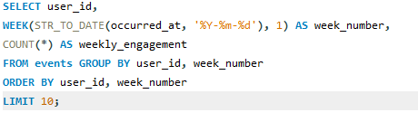
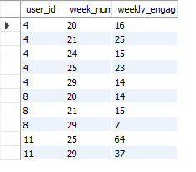
Weekly User Engagement:
SELECT user_id,
WEEK(STR_TO_DATE(occurred_at, '%Y-%m-%d'), 1) AS week_number,
COUNT(*) AS weekly_engagement
FROM events GROUP BY user_id, week_number
ORDER BY user_id, week_number
LIMIT 10;
User_id | Week_num | Weekly_engag
4 | 20 | 16
4 | 21 | 25
4 | 24 | 15
4 | 25 | 23
4 | 29 | 14
8 | 20 | 14
8 | 21 | 15

Slide 19

User Growth Analysis:

Slide 20
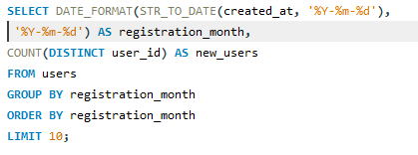
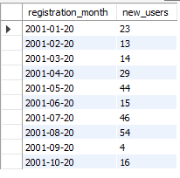
User Growth Analysis:
SELECT DATE_FORMAT(STR_TO_DATE(created_at, '%Y-%m-%d'), '%Y-%m-%d') AS registration_month,
COUNT(DISTINCT user_id) AS new_users
FROM usersGROUP BY registration_month
ORDER BY registration_month
LIMIT 10;
REG_Month | New_Users
2001-01-20 | 23
2001-02-20 | 13
2001-03-20 | 14
2001-04-20 | 29
2001-05-20 | 44
2001-06-20 | 15
2001-07-20 | 46

Slide 21

Weekly Retention Analysis:

Slide 22
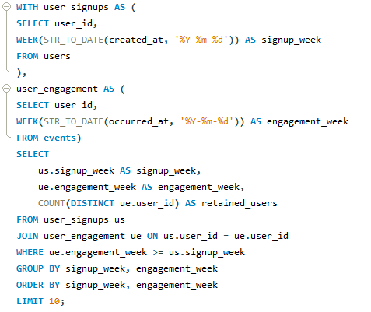
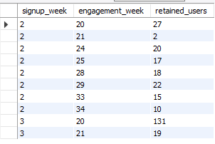
Weekly Retention Analysis:

Slide 23

Weekly Engagement Per Device:

Slide 24
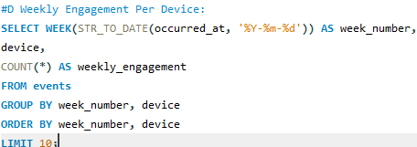
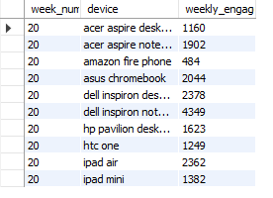
Weekly Engagement Per Device:
SELECT WEEK(STR_TO_DATE(occurred_at, '%Y-%m-%d')) AS week_number,device,COUNT(*) AS weekly_engagementFROM eventsGROUP BY week_number, deviceORDER BY week_number, deviceLIMIT 10;
Week num | Device | Week Engang
1160 | acer aspire desktop | 20
1902 | acer aspire notebook | 20
484 | amazon fire phone | 20
2044 | asus chromebook | 20
2378 | dell inspiron desktop | 20
4349 | dell inspiron notebook | 20
1623 | hp pavilion desktop | 20
1249 | htc one | 20

Slide 25

Email Engagement Analysis:

Slide 26
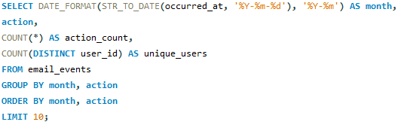
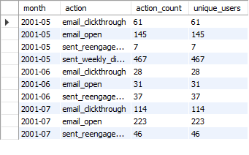
Email Engagement Analysis:
SELECT DATE_FORMAT(STR_TO_DATE(occurred_at, '%Y-%m-%d'), '%Y-%m') AS month,
action,COUNT(*) AS action_count,
COUNT(DISTINCT user_id) AS unique_users
FROM email_events
GROUP BY month, action
ORDER BY month, action
LIMIT 10;

Slide 27
Overview
Project Overview: Operation Analytics and Investigating Metric Spikes
This project, titled "Operation Analytics and Investigating Metric Spikes," revolves around the role of a Lead Data Analyst within a company, akin to Microsoft. The core objectives include leveraging advanced SQL skills to conduct operational analytics and investigating sudden changes in key metrics. The primary aim is to provide actionable insights to different departments—operations, support, and marketing—contributing to the enhancement of overall company operations.
Analysis Approach:
1. End-to-End Operations Analysis
2. Daily Metric Spike Investigation
3. Cross-Departmental Collaboration
Tech-Stack Used:
SQL Querying Tool: MySQL Workbench (version 8.0CE)
Insights from Operation Analytics and Investigating Metric Spikes Project:
Operational Efficiency: 2. Daily Metric Spikes: 3. Cross-Departmental Collaboration:
Visualization Impact: 5. Data Quality and Preprocessing: 6. Version Control and Collaboration:
7. Continuous Improvement:
Result
Overall Impact: The project has significantly contributed to a deeper understanding of the company's operations, enhanced decision-making processes, and the establishment of a culture where data-driven insights are integral to daily operations. The achievements outlined above collectively reflect a positive

Slide 28
THANK YOU
:-Suraj Kumar

